Slide 1

Holistic Self-Improvement AI Platform
School of Computer Science and Engineering
Department of Computer Science and Engineering
Submitted By: SUHANI CHANDNA
2427030558
Supervised By:
TRIPTI KULSHRESHTHA

Slide 2
Outline
Introduction
Literature Review
Problem Statement
Proposed Solution
Objectives

Slide 3
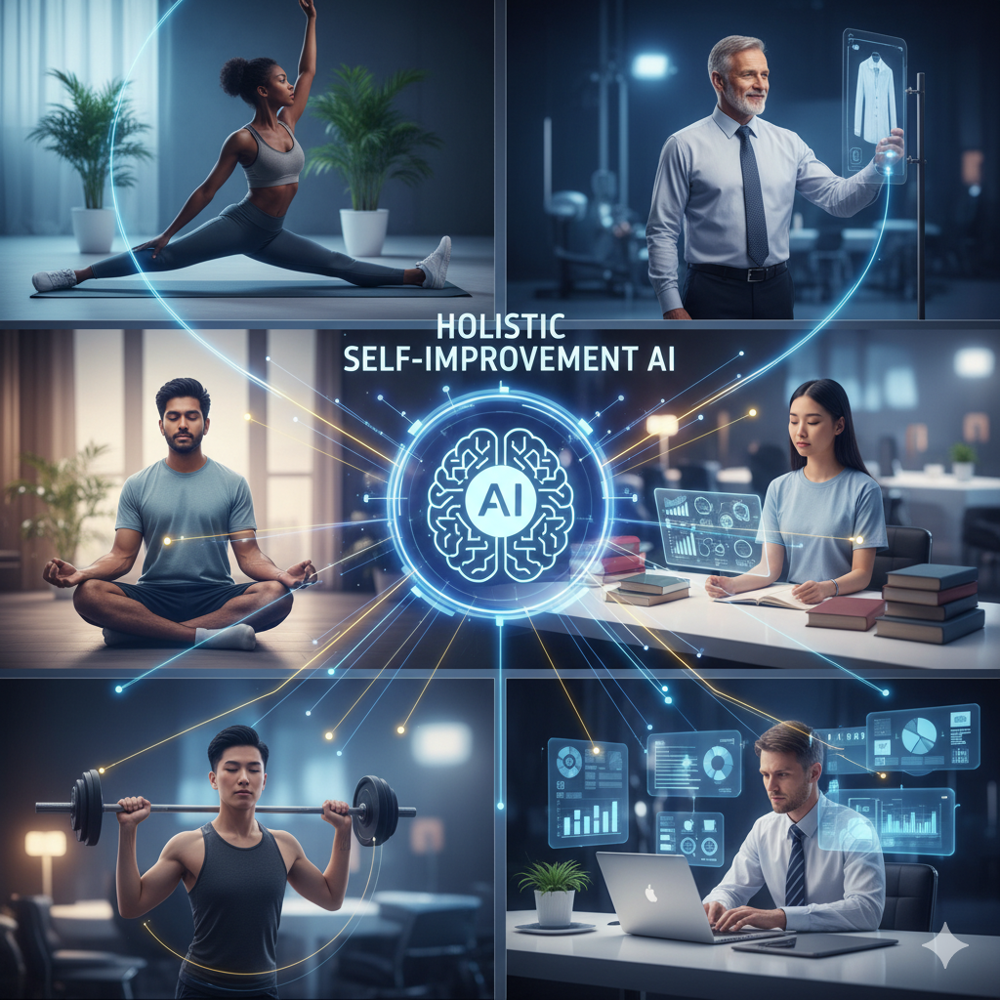
Introduction
In today’s fast-paced world, individuals often struggle to maintain balance across multiple dimensions of life, including physical health, fitness, mental wellness, academics, work productivity, and personal style.
Existing self-improvement apps generally focus on one area and provide generic recommendations, which fail to address individual needs.

Slide 4

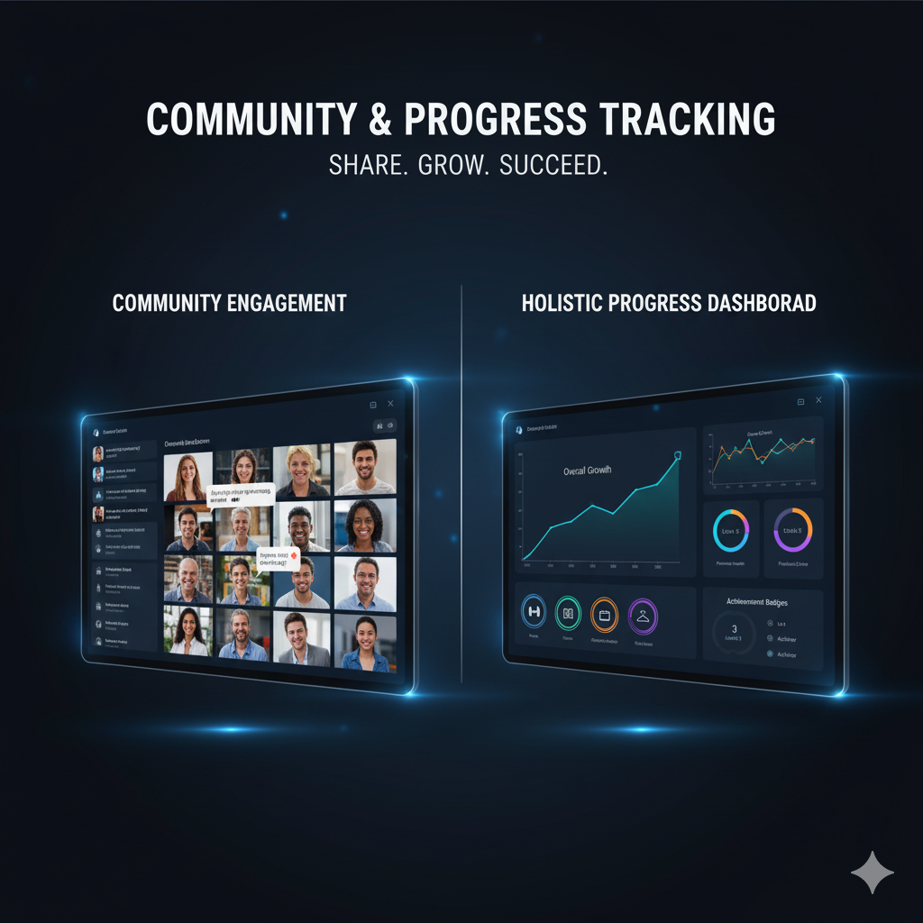
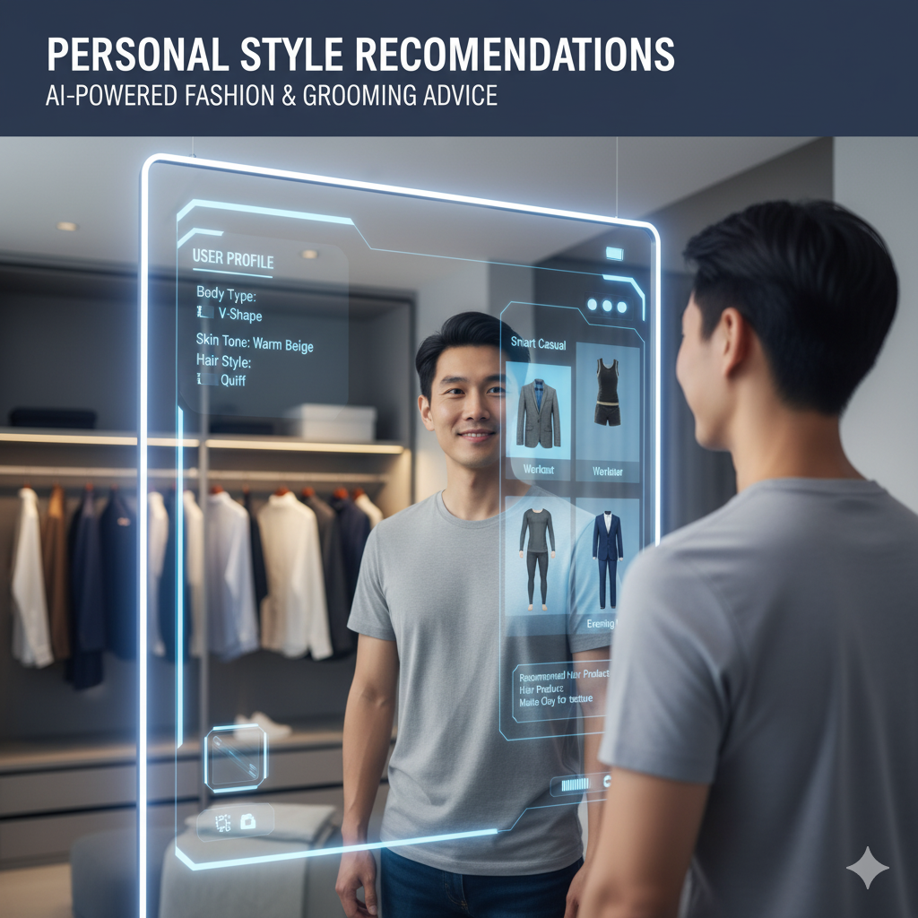
This project proposes a Holistic Self-Improvement AI Platform that combines facial recognition, lifestyle questionnaires, and pattern analysis to deliver personalized recommendations. The platform also includes a progress tracker and a basic community feature for peer engagement, promoting a more interactive and adaptive approach to personal growth

Slide 5


Literature Review
Physical Health & Fitness Apps:
Many apps provide workout routines and diet plans but lack personalization based on body type, health history, and medical conditions.
2. Academic & Work Improvement Platforms:
Tools such as productivity trackers or e-learning platforms assist with planning, yet they often ignore individual learning styles and stress factors.

Slide 6
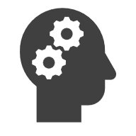

3. Mental Health & Wellness Solutions:
Sentiment analysis and mood detection have been applied to online journals or social media posts to detect stress or depression, but integration with physical fitness and learning improvement is rare.
4. Personal Styling & Grooming Recommendations:
Fashion recommendation systems exist but are mostly rule-based, without considering a user’s holistic profile including body type, complexion, and personal preferences.
The proposed platform seeks to integrate all these dimensions into a single AI-powered solution, providing customized, actionable, and measurable guidance.

Slide 7
Problem Statement
Individuals struggle with holistic self-improvement due to fragmented, generic advice and lack of personalized, integrated tracking and guidance across multiple areas.

Slide 8
Proposed Solution
The proposed Holistic Self-Improvement Website will:
Physical Health Analysis:
Use body type classification, questionnaires, and medical history inputs to generate personalized health and lifestyle recommendations.
Fitness & Wellness Guidance:
Provide basic-to-advanced fitness plans, track progress, and suggest improvements based on performance data.

Slide 9
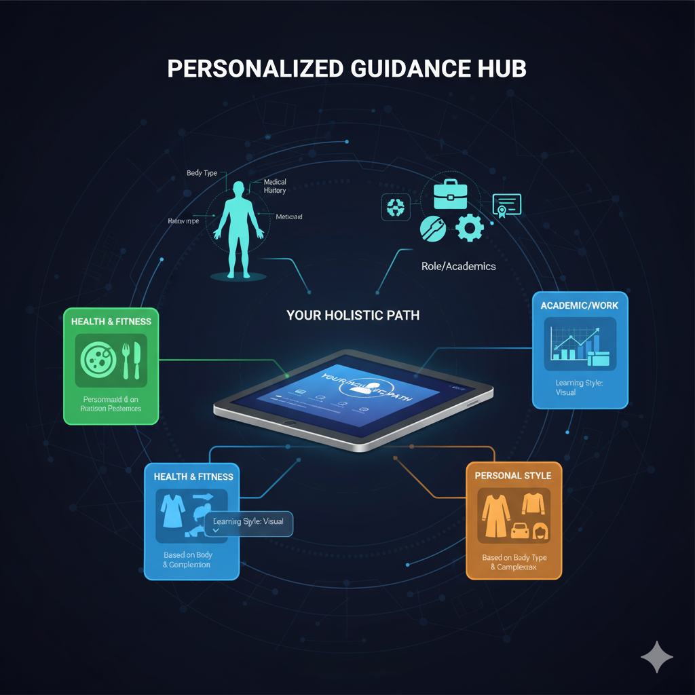
Academic / Work Enhancement:
Collect role/designation and domain-specific inputs to generate tailored productivity and learning strategies.
Personal Style Recommendations:
Suggest clothing and grooming tips based on body type, complexion, and personal preferences.
Community Engagement:
Allow users to share advice, tips, and experiences, creating a supportive environment.

Slide 10
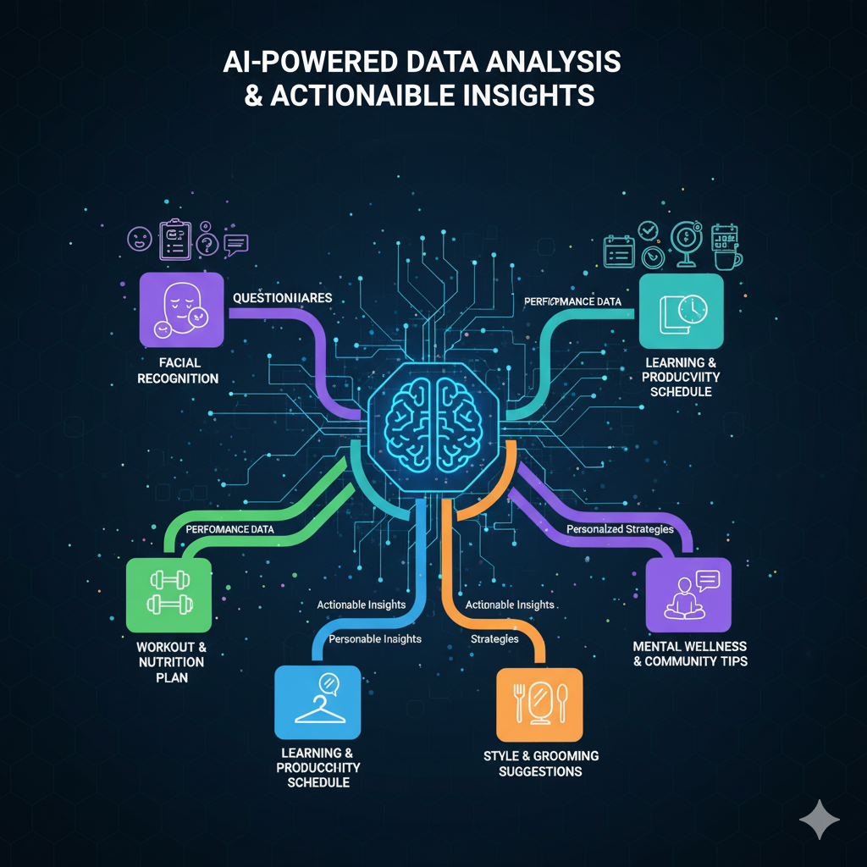
Progress Tracking:
Visual dashboards to monitor improvements in health, fitness, learning, and style.
Implementation Approach:
AI/ML Techniques:
Facial recognition, emotion detection, pattern recognition, and recommendation systems.
Front-End:
Web interface using HTML, CSS, JavaScript and React, Vue, or Angular.
Database:
MySQL or SQLite for storing user data and progress.
Visualization:
Matplotlib, Plotly, or Chart.js for dashboards.

Slide 11
Objectives
To provide personalized guidance in physical health, fitness, academics, mental wellness, and personal style.
To analyze user data from facial recognition, questionnaires, and patterns to generate actionable insights.
To implement a progress tracking system for holistic growth.
To enable community interaction for sharing advice and maintaining motivation.
To develop an AI-powered platform that adapts to user progress and evolving needs.

Slide 12
References
Patel, R., & Sharma, A. (2021). Integrating Mental Health and Physical Fitness Tracking through Machine Learning. International Journal of AI in Healthcare, 5(2), 12–25.
Russell, S., & Norvig, P. (2021). Artificial Intelligence: A Modern Approach (4th Edition). Pearson.

Slide 13
Thank You

